Slide 1

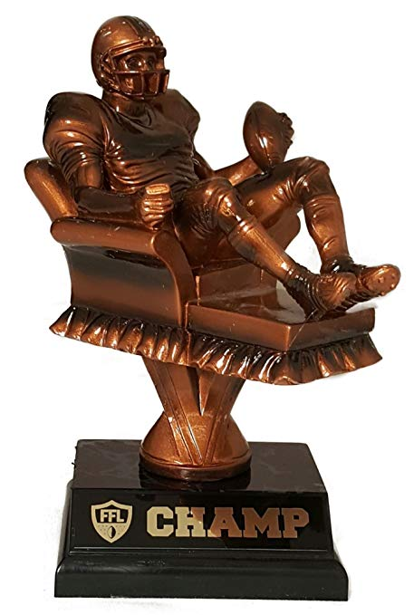
Welcome to the AFL - Armchair Fantasy League

Slide 2
Welcome to the AFL - Armchair Fantasy League
Team Members:
Chris Boyce, Sebastian Hernandez, Luke Smith, Mike McGuire
Rough Breakdown of Tasks:
Chris – MYSQL Database / data sets management, JavaScript , UI
Mike – Sequelize, Node.js, Express, Handlebars, Socket.io
Sebastian – Front End/UI, JavaScript
Luke – Sequelize, Node.js, Express, Handlebars, JavaScript
Technologies Used: Node.js Express Web Server - MySQL Database - Sequelize ORM Socket.io FlipClock.js | - JavaScript/jQuery - Handlebars - HTML / CSS - Deployed on Heroku

Slide 3
Welcome to the AFL - Armchair Fantasy League
Game Premise:
AFL is a Fantasy Football game, based on 2018 statistical NFL player data and upcoming 2019 NFL predications.
Play 2-4 other players in a LIVE online roster selection game.
Use your knowledge of player performance, team trades, coaching changes, and draft picks to select the best 7-man roster.
Each NFL player is assigned a position ranking based on the average 2019 projected fantasy rankings from multiple online sources such as ESPN, CBS Sports, Yahoo Sports, etc.
The Goal is to put together a roster with the highest ranking point total to win the game and be crowned the Armchair Fantasy League Champion!

